Slide 1
Foreign Direct Investment in India
Comprehensive Analysis (2000-01 to 2016-17)

Slide 2

Introduction
Foreign Direct Investment (FDI) is a key driver of economic growth, facilitating technology transfer, job creation, and enhancing productivity.
This presentation provides a comprehensive analysis of FDI inflows into India from 2000-01 to 2016-17, covering sector-wise distribution and year-wise trends.

Slide 3

Data Overview
The dataset covers FDI inflows into India across multiple sectors over 17 years.
Each entry represents the FDI amount received by a sector in a particular financial year.
The analysis aims to uncover insights into sector preferences and temporal investment trends.

Slide 4
Top Sectors by FDI
The top sectors by total FDI received from 2000-01 to 2016-17 are:
1. Services Sector: ₹59476.49 crores
2. Computer Software & Hardware: ₹24669.49 crores
3. Construction Development: ₹24293.09 crores
4. Telecommunications: ₹16949.38 crores
5. Automobile Industry: ₹15235.98 crores

Slide 5
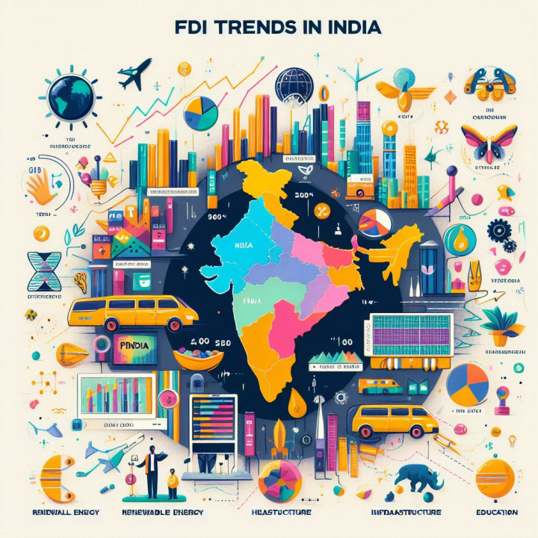
Year-wise FDI Trends
FDI inflows into India have increased significantly, especially after 2006-07.
Major growth observed during 2007-08 and 2016-17, indicating a positive investment climate.
Peak FDI recorded in 2016-17 at ₹43,478.26 crores, demonstrating strong investor confidence.

Slide 6
Year-wise FDI Trends

Slide 7
FDI Growth Patterns
The analysis reveals a steady increase in FDI inflows over the years, with a notable surge after 2006-07.
Key factors contributing to growth include policy reforms, economic liberalization, and enhanced global engagement.
The trend indicates a robust and resilient investment environment in India.

Slide 8

Policy Impacts on FDI
Government policies have played a pivotal role in attracting FDI, including:
Liberalization of investment regulations
Implementation of GST
Initiatives like 'Make in India'
These policies have enhanced India's appeal as a global investment destination.

Slide 9

Conclusion
The comprehensive analysis highlights the Services Sector as the top FDI recipient, with consistent growth across various sectors.
The upward trend in FDI inflows reflects India's strategic policy initiatives and economic potential.
Continued reforms and global engagement will likely sustain and enhance this positive trend.

Slide 10
Thank you
KARTIK MEENA
9968217216
kartik2580@gmail.com

